Slide 1
ODOO
Name: Shandhini

Slide 2
TABLE OF CONTENT
Introduction
Poster’s 5 forces
SWOT
GAP
3 P’s
STP
Profitability framework
Marketing mix model
3 C’s framework
Product life cycle
Conclusion

Slide 3
INTRODUCTION
Odoo is an open-source business software suite that provides a comprehensive set of applications to manage various business functions, including accounting, human resources, customer relationship management (CRM), inventory management, and more. Founded by Fabien Pinckaers in 2005, Odoo was initially named TinyERP and later rebranded as OpenERP before adopting the name Odoo in 2014. The company operates primarily as an ERP (Enterprise Resource Planning) software provider, offering a range of modules that can be tailored to the needs of small and medium-sized businesses (SMBs) as well as large enterprises. Odoo has a modular approach, allowing businesses to adopt and integrate different functionalities as needed, making it flexible and scalable.

Slide 4
POSTER’S 5 FORCES
Threat of New Entrants: Moderate
Barriers to Entry
Customer Loyalty and Trust
Bargaining Power of Suppliers: Low
Open-Source Nature
Third-Party Modules
Hosting and Infrastructure
Bargaining Power of Buyers: High
Customer Choices
Price Sensitivity
Customization Requirements
Threat of Substitutes: Moderate to High
Alternative ERP Solutions
Industry-Specific Software
In-House Solutions
Competitive Rivalry: High
Many Competitors
Innovation and Development
Global Market Presence

Slide 5
SWOT ANALYSIS
Strengths
Affordability
User-Friendly Interface
Scalability
Global Community and Ecosystem
Weaknesses
Limited Advanced Features
Customization Challenges
Cloud Service Limitations
.
Opportunities
Expanding Global Reach
Focus on AI and Automation
Partnerships and Strategic Alliances
Threats
Intense Competition
Economic Downturns
Changing Technology Landscape

Slide 6
GAP ANALYSIS
GAP
.
CURRENT
STATE
DESIRED
STATE
Comprehensive modular structure
User-friendly interface
Open-source flexibility
Enhanced AI capabilities for data analytics
Enhanced AI capabilities for data analytics
Greater integration with third-party applications
Missing features
Lower customer satisfaction
Inefficient processes leading

Slide 7
3 P’s
.
Product
Modular Structure
Customization and Flexibility
User-Friendly Interface
Integration Capabilities
Unique Selling Proposition
Price
Pricing Model
Subscription-Based Pricing
Free Community Version
Cost-Effectiveness
Place
Distribution Channels
Global Reach
Community Engagement

Slide 8
STP
. Segmentation
Small and Medium-Sized Enterprises (SMEs): Odoo primarily targets SMEs looking for affordable and scalable ERP solutions.
The platform offers solutions tailored for production planning and quality control.
Targeting
Odoo’s pricing model and modular approach are particularly appealing to SMEs looking for cost-effective ERP solutions without sacrificing functionality.
Odoo has the potential to target emerging markets where businesses are increasingly looking for affordable ERP solutions.
Positioning
The open-source nature of Odoo allows businesses to customize the software according to their specific needs, positioning it as a flexible solution in the ERP market.
By focusing on a simple, intuitive interface, Odoo positions itself as accessible for non-technical users, making ERP adoption easier for businesses with limited IT resources.

Slide 9
PROFITABILITY FRAMEWORK
. Revenue Generation
Modular Pricing: Odoo’s subscription model allows customers to pay for only the modules they use, enhancing revenue opportunities from upselling additional modules.
Cost Management
Utilizing cloud computing can lower infrastructure costs, as Odoo can scale its resources according to demand
Customer Retention and Satisfaction
Regular updates and enhancements based on customer feedback ensure that the product remains competitive and meets the evolving needs of users.
Competitive Landscape
Emphasizing unique features, such as customization capabilities and a user-friendly interface, can help Odoo stand out in a crowded market.

Slide 10
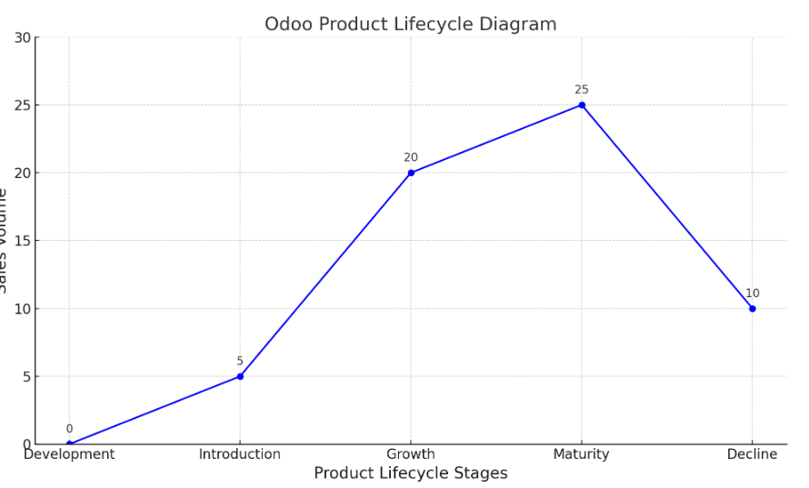
PRODUCT LIFECYCLE

Slide 11
3 C’s FRAMEWORK
.
Company
Modular Design-Odoo offers over 30 core modules and thousands of community
Cost-Effective Solutions
Strong Community Support
Customers
Small and Medium-Sized Enterprises (SMEs)
Startups
Flexibility
Industry-Specific Companies: Odoo caters to various sectors, including retail.
Competitors
SAP: Known for its robust offerings
Microsoft Dynamics 365
Odoo's combination of affordability, flexibility, and a vast array of modules positions it well against larger, more expensive competitors

Slide 12
MARKETING MIX MODEL
Product
Odoo benefits from a strong developer community that contributes additional features, modules, and customizations, enhancing the product's functionality and adaptability.
Price
Flexible Payment Plans: Customers can choose between different pricing tiers based on the number of users and modules, enabling them to scale as their business grows.
Place
Odoo has established a network of official partners and resellers who assist in implementation, customization, and ongoing support, expanding its market reach.
Promotion
Odoo invests in search engine optimization (SEO) and online advertising to increase visibility and attract potential customers searching for ERP solutions.

Slide 13
RECOMMENDATION
Develop comprehensive onboarding programs and training
Showcase success stories and case studies from satisfied customers
Integrate AI and automation tools to streamline business
Ensure that Odoo complies with local and international regulations
Increase language support within the software to cater to non-English speaking markets, broadening the customer base.
Promote sustainability by integrating features that help businesses manage their environmental impact and by adopting eco-friendly practices in operations.

Slide 14
CUSTOMER FEEDBACK
Many users praise Odoo for its intuitive user interface and ease of navigation.
Some users report a steep learning curve for new features, particularly for non-technical users
Users generally report good performance and reliability, especially with the cloud-based version.
Some customers have encountered performance issues during peak usage times, leading to slower response rates.
Many users appreciate the extensive documentation and community resources available for learning and troubleshooting.
Some feedback suggests that training resources could be more structured, especially for new users who may benefit from more guided tutorials.

Slide 15
CONCLUSION
Odoo has established itself as a leading player in the ERP (Enterprise Resource Planning) market, particularly for small and medium-sized enterprises (SMEs). Its open-source nature, combined with a comprehensive suite of modules covering various business functions, offers users a flexible and cost-effective solution that can be tailored to meet their specific needs. Customer feedback has highlighted several strengths of Odoo, including its user-friendly interface, extensive functionality, and modular design.

